Slide 1

SHRI VISHNU ENGINEERING COLLEGE FOR WOMEN
AUTONOMOUS :: BHIMAVARAM
A Deep Dive into Predicting used Car Prices with Machine Learning
PROJECT GUIDE:
Mr. P. Raju
PRESENTED BY:
B. Sireesha - 22B01A4603
B. Prasanna - 22B01A4605
B. Lohitha - 22B01A4607
G. HemaLatha - 22B01A4616
V. Samatha - 22B01A4651

Slide 2
Introduction
1
Scope of Car Price Predictions
Predicting car prices accurately impacts both the automotive industry and consumers, enabling better pricing strategies and informed purchasing decisions.
2
Data Collection and Preprocessing
Initial steps involve gathering comprehensive data from various sources and preprocessing it to ensure quality and consistency for machine learning models.
3
Overview of Machine Learning Algorithms
Introduction to the machine learning algorithms used in this study, including Linear Regression and Random Forest, and their relevance to car price prediction.

Slide 3
Literature Survey
Sameerchand Pudaruth, “Predicting the Price of Used Cars using Machine Learning Techniques”;(IJICT 2014)
Enis gegic, Becir Isakovic, Dino Keco, Zerina Masetic, Jasmin Kevric, ”Car Price Prediction Using Machine Learning”; (TEM Journal 2019)
Ning sun, Hongxi Bai, Yuxia Geng, Huizhu Shi, “Price Evaluation Model In Second Hand Car System Based On BP Neural Network Theory”; (Hohai University Changzhou, China)
Nitis Monburinon, Suwat Rungpheung, Sabir Buya, Pitchayakit Boonpou, “Prediction of Prices for Used Car by using Regression Models” (ICBIR 2018).

Slide 4
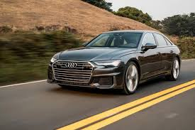
Methodology
1
Data Preprocessing
Handling missing values, encoding categorical variables, and feature scaling to prepare the data for machine learning models
2
Model Training
Implementing Linear Regression and Random Forest algorithms to predict car prices based on the preprocessed data.
3
Model Evaluation
Assessing the performance of the models using metrics like Mean Absolute Error (MAE), Mean Squared Error (MSE), and R-squared.

Slide 5
Algorithms
Linear Regression
Random Forest
Predicts a continuous target variable based on the linear relationship between input features and the target, with assumptions like linearity, independence of errors, homoscedasticity, and normality of residuals.
An ensemble method that builds multiple decision trees and merges them to obtain a more accurate and stable prediction, using bootstrap sampling and random feature selection.

Slide 6
Implementation
Data Preprocessing
Model Training
Model Evaluation
Handling missing values, encoding categorical variables, and feature scaling to prepare the data for machine learning models.
Implementing Linear Regression and Random Forest algorithms to predict car prices based on the preprocessed data.
Assessing the performance of the models using metrics like Mean Absolute Error (MAE), Mean Squared Error (MSE), and R-squared.

Slide 7
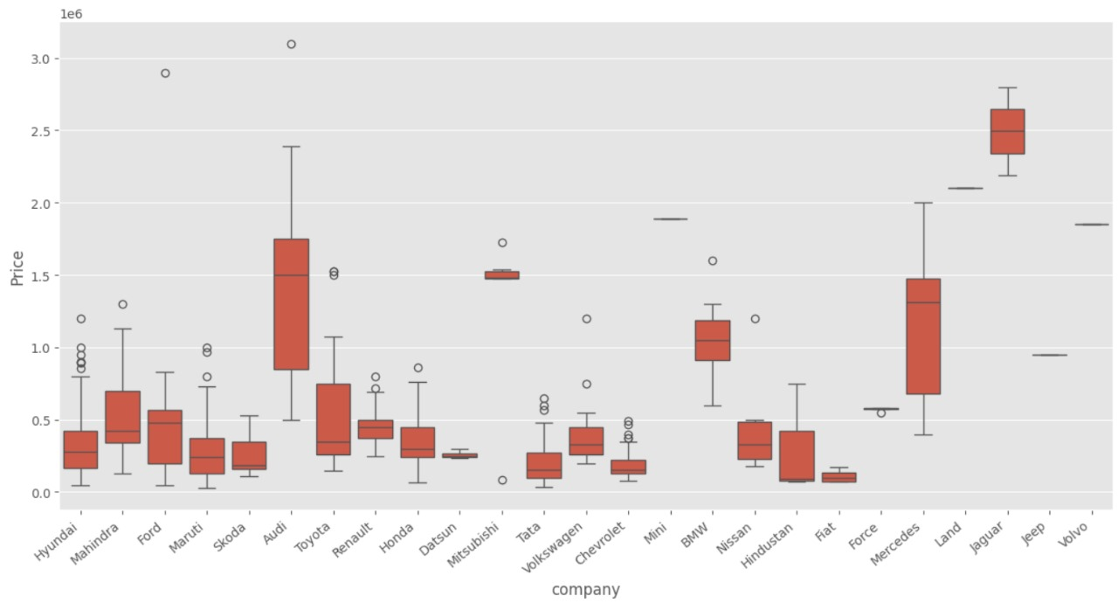
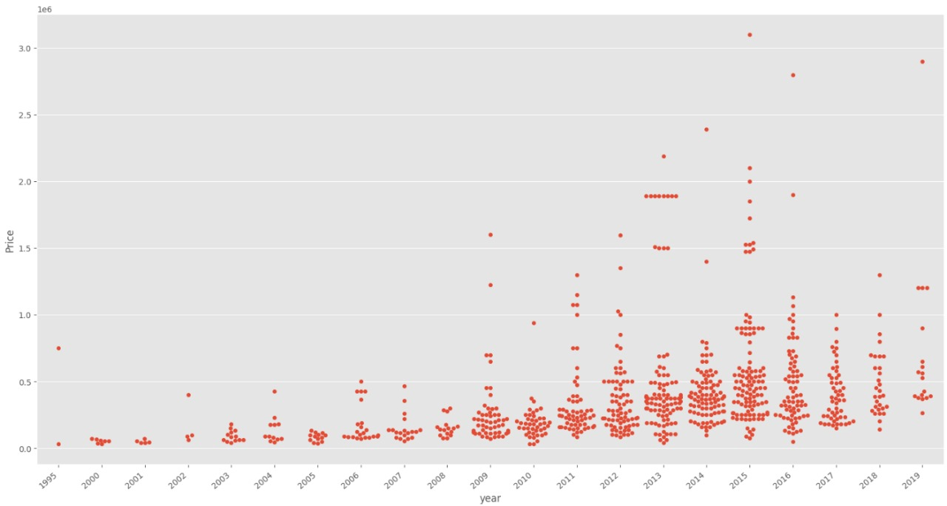
Graphs Using Random Forest
Boxplot
Between company and price
Swarmplot
Between year and price

Slide 8
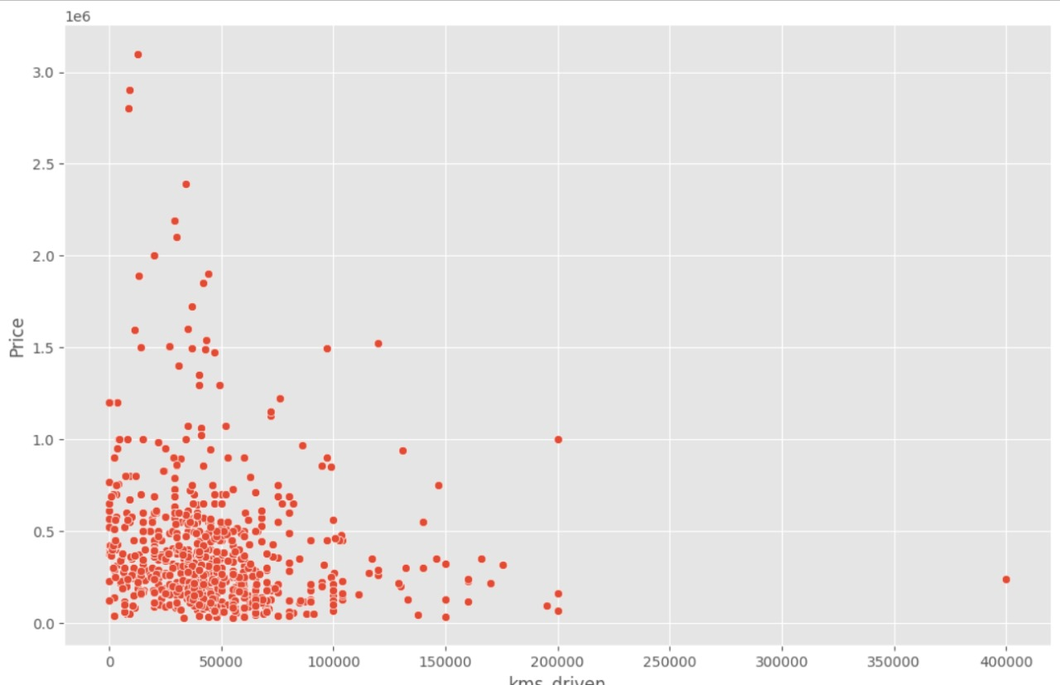
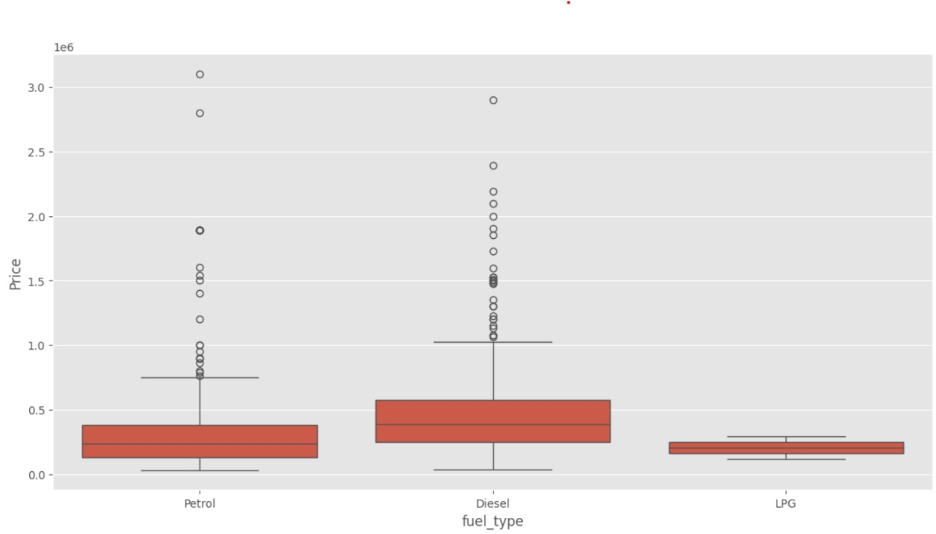
Relplot
Between kilometers driven and price
Boxplot
Between fuel type and Price

Slide 9
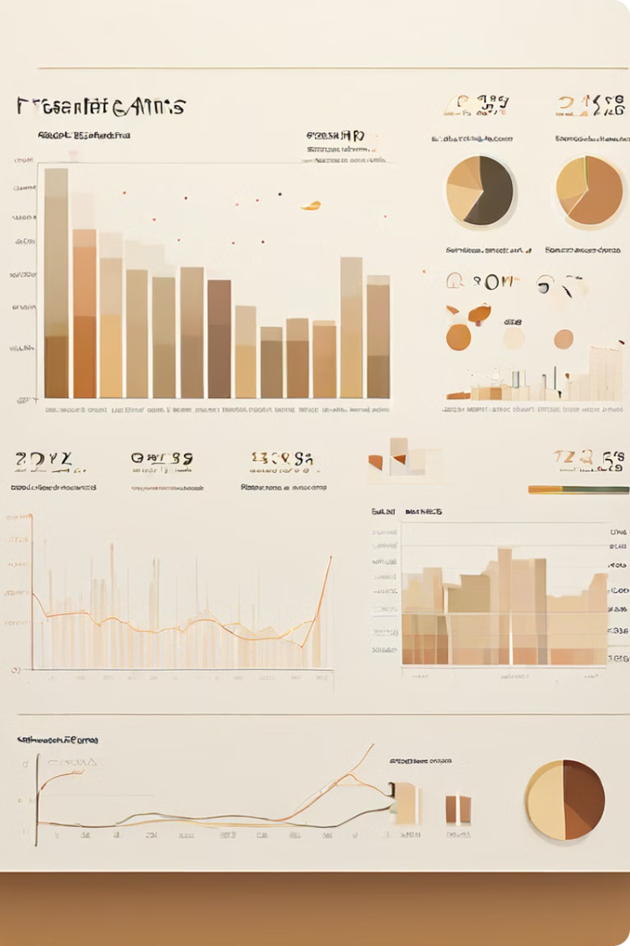
Experimental Results
Model
R-squared
Accuracy
Linear Regression
0.54
0.92
Random Forest
0.66
0.94
The Random Forest model outperformed the Linear Regression model, achieving R-squared value and accuracy. This suggests that the Random Forest algorithm is better suited for capturing the linear relationships within the car price data.

Slide 10
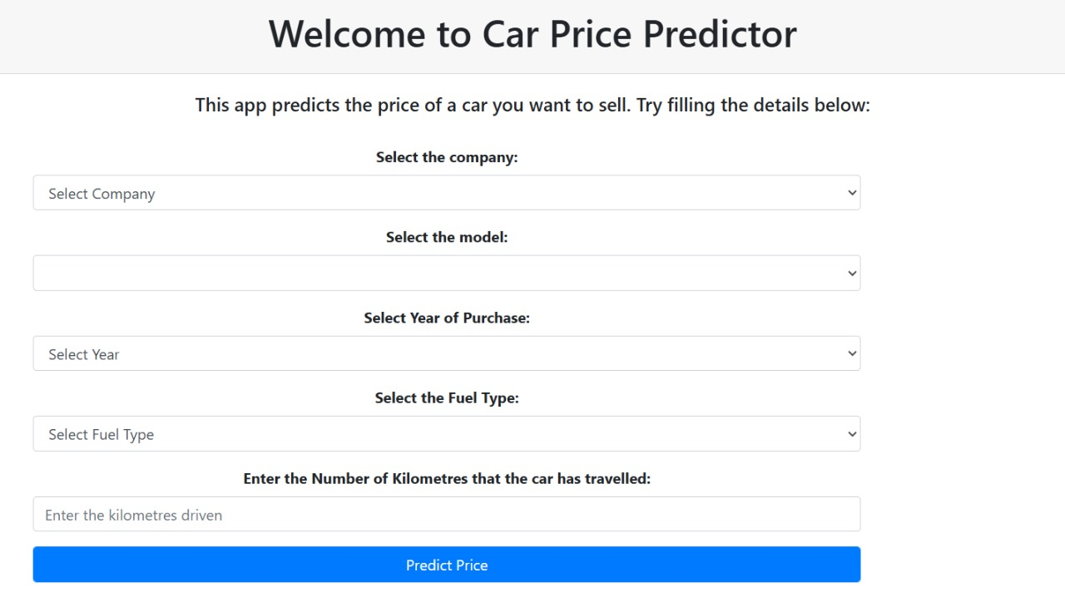
Input Screen

Slide 11
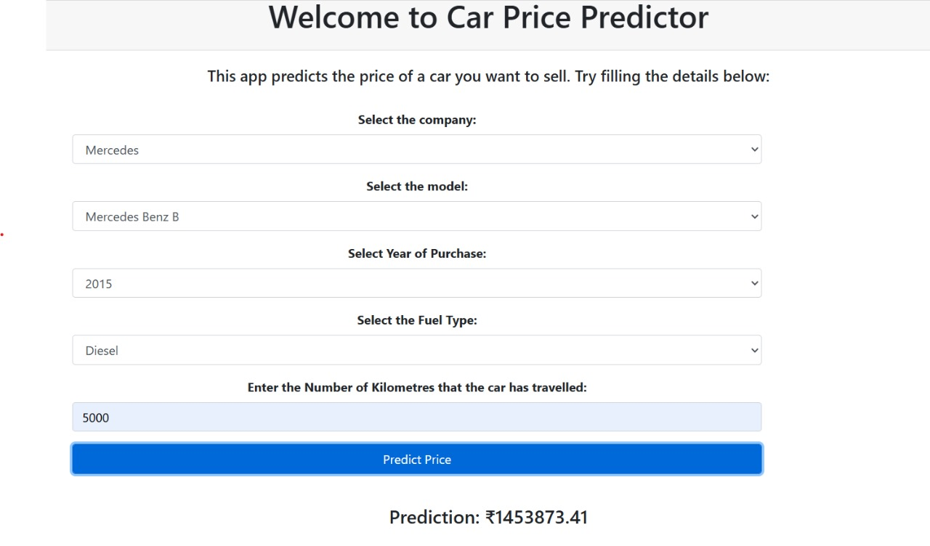
Output Screen

Slide 12
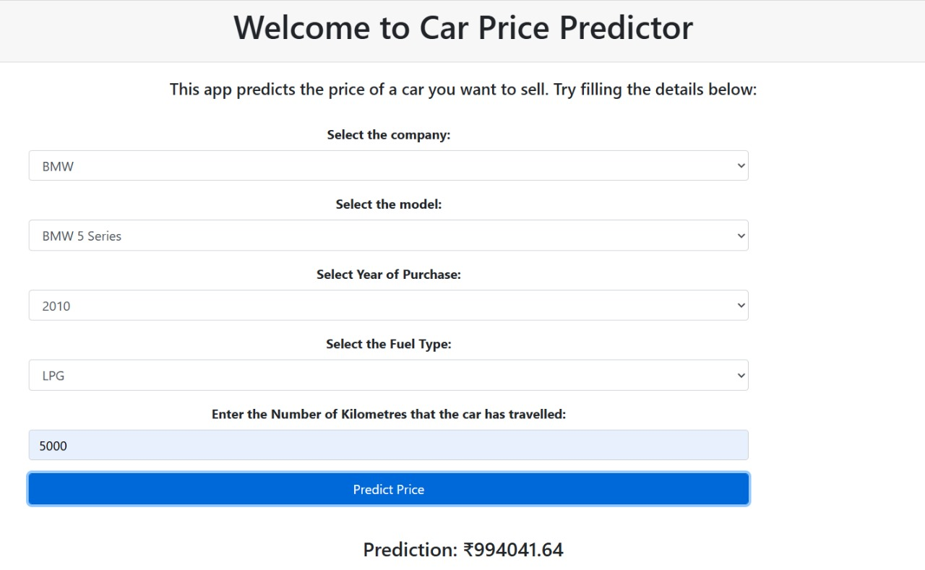
Output Screen

Slide 13



Conclusion
Impact on Industry
The implementation of machine learning for car price predictions can revolutionize the automotive industry by providing more accurate and dynamic pricing models.
Future Prospects
There is significant potential for further growth and innovation in the field of machine learning-based car price predictions, including exploring advanced models and incorporating additional features for enhanced accuracy.

Slide 14

References
NATIONAL TRANSPORT AUTHORITY. 2014.
Available from: http://nta.gov.mu/English/Statistics/Pages/Archive.aspx [Accessed 15 January 2014]
MOTORS MEGA. 2014.
Available from: http://motors.mega.mu/news/2013/12/17/auto-market8decrease-sales-newcars/
[Accessed 17 January 2014].
LISTIANI, M., 2009. Support Vector Regression Analysis for Price Prediction in a Car Leasing

Slide 15



